Slide 1
Case Study on CAR DETAILS FROM CAR DEKHO
Create By:
Tejas Ghute, Vishal Pimple, Chinmay Modak

Slide 2
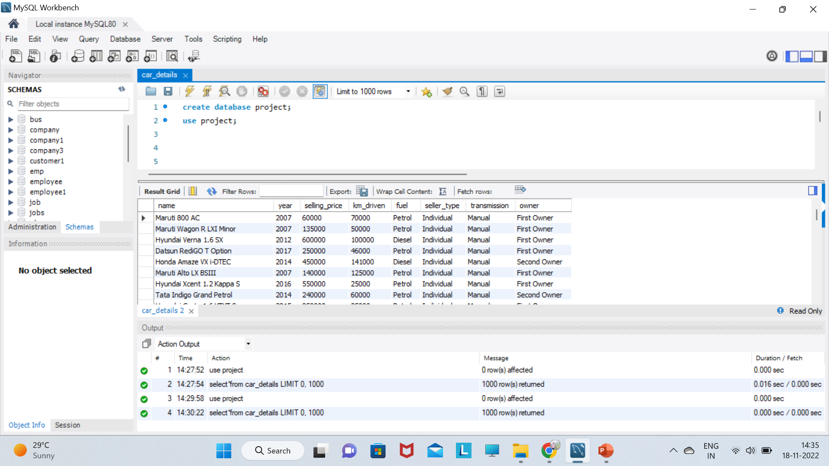
select*from car_details;

Slide 3
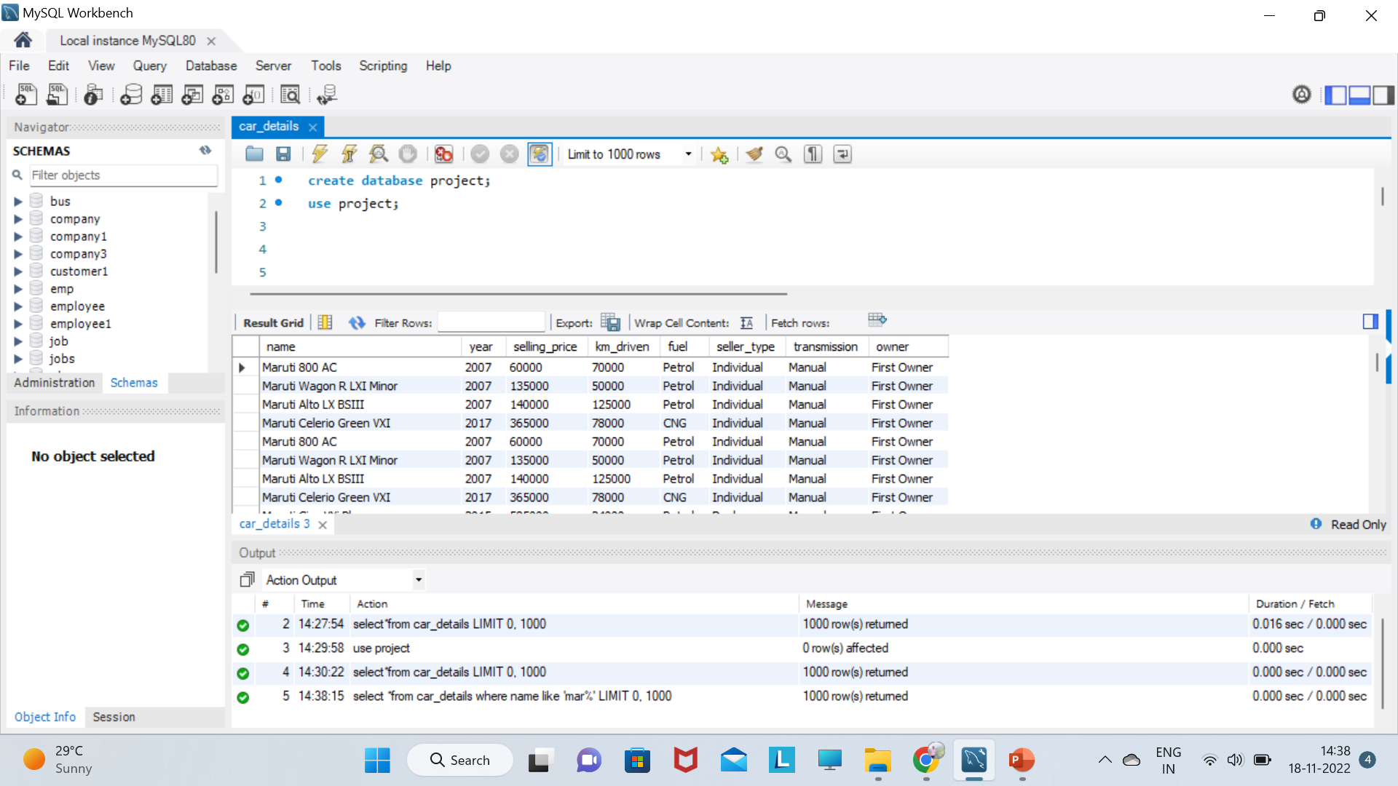
select *from car_details where name like 'mar%';

Slide 4
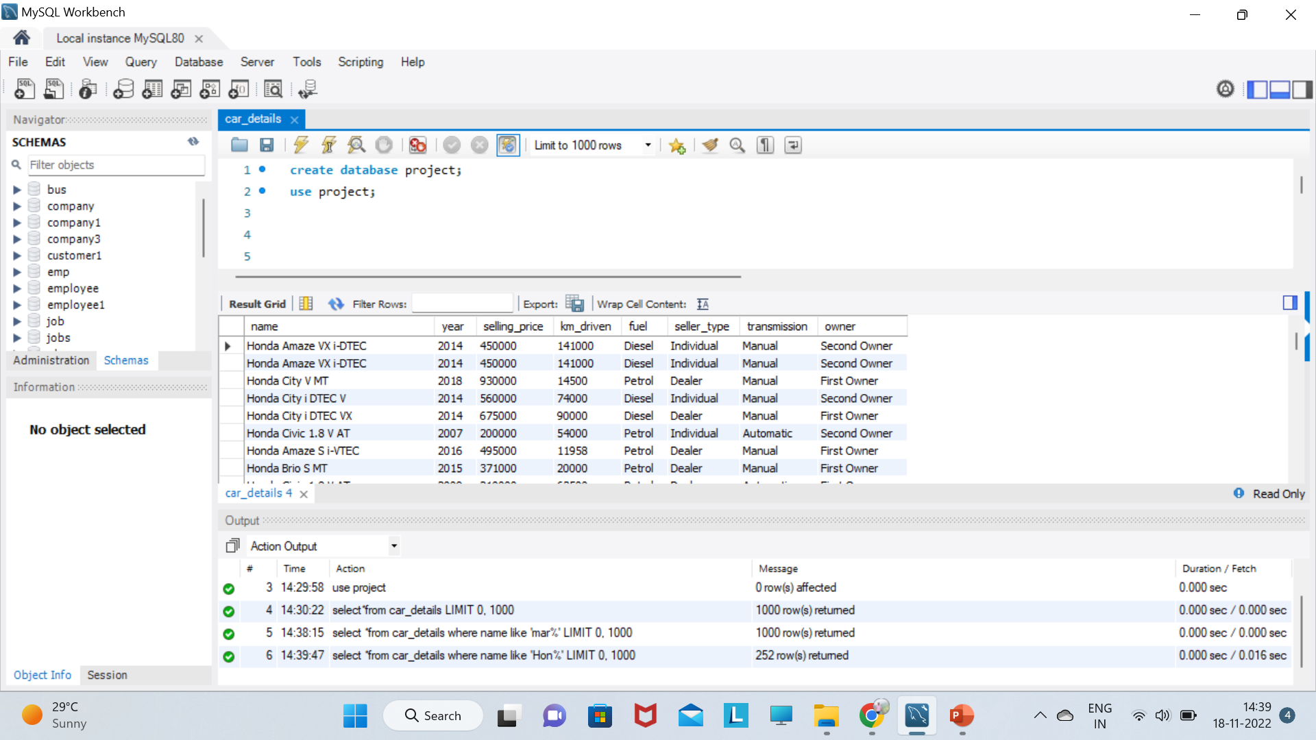
select *from car_details where name like 'Hon%';

Slide 5
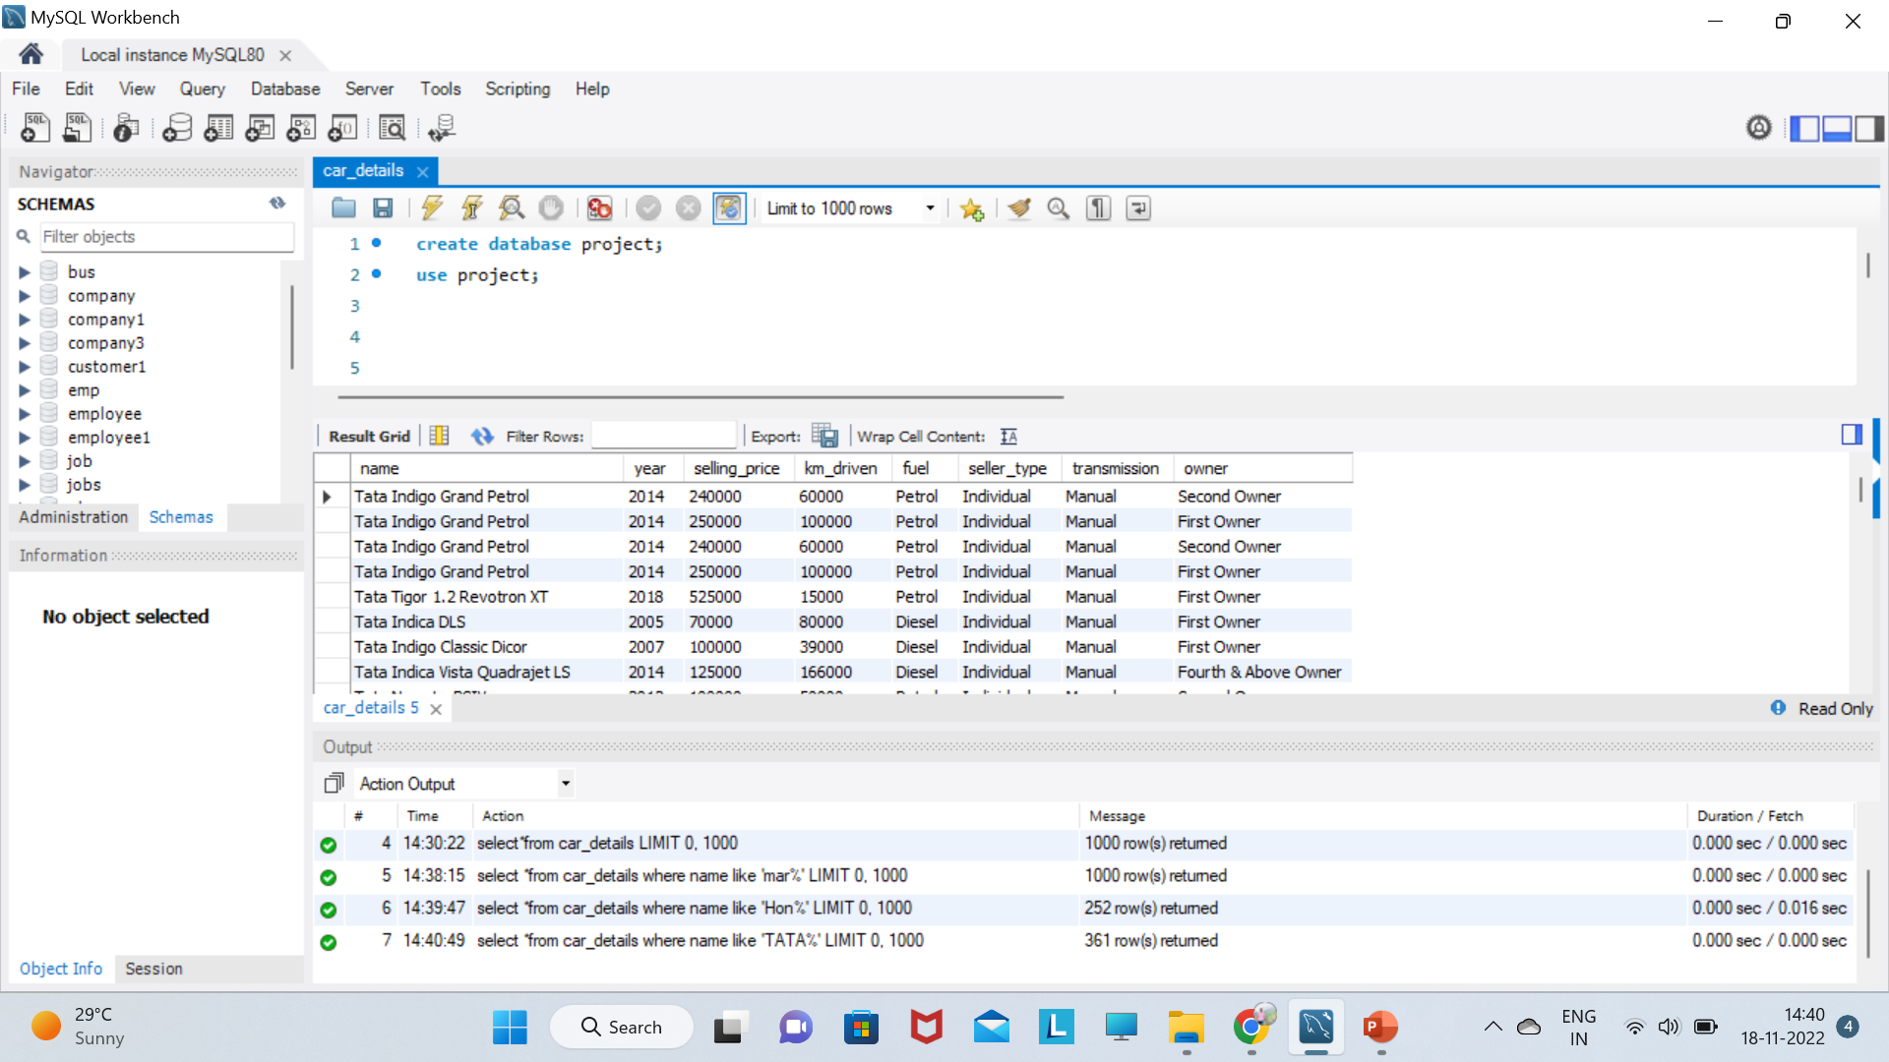
select *from car_details where name like 'TATA%';

Slide 6
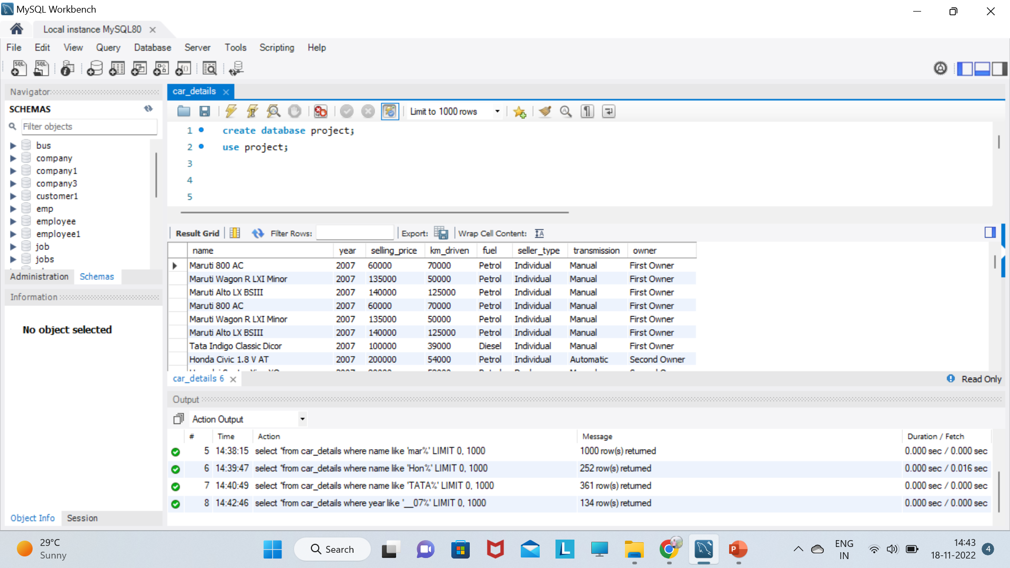
select *from car_details where year like '__07%';

Slide 7
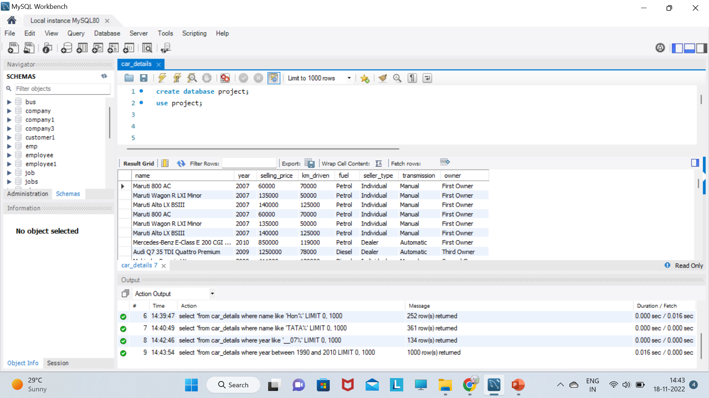
select *from car_details where year between 1990 and 2010;

Slide 8

select *from car_details where year between 2011 and 2015;

Slide 9
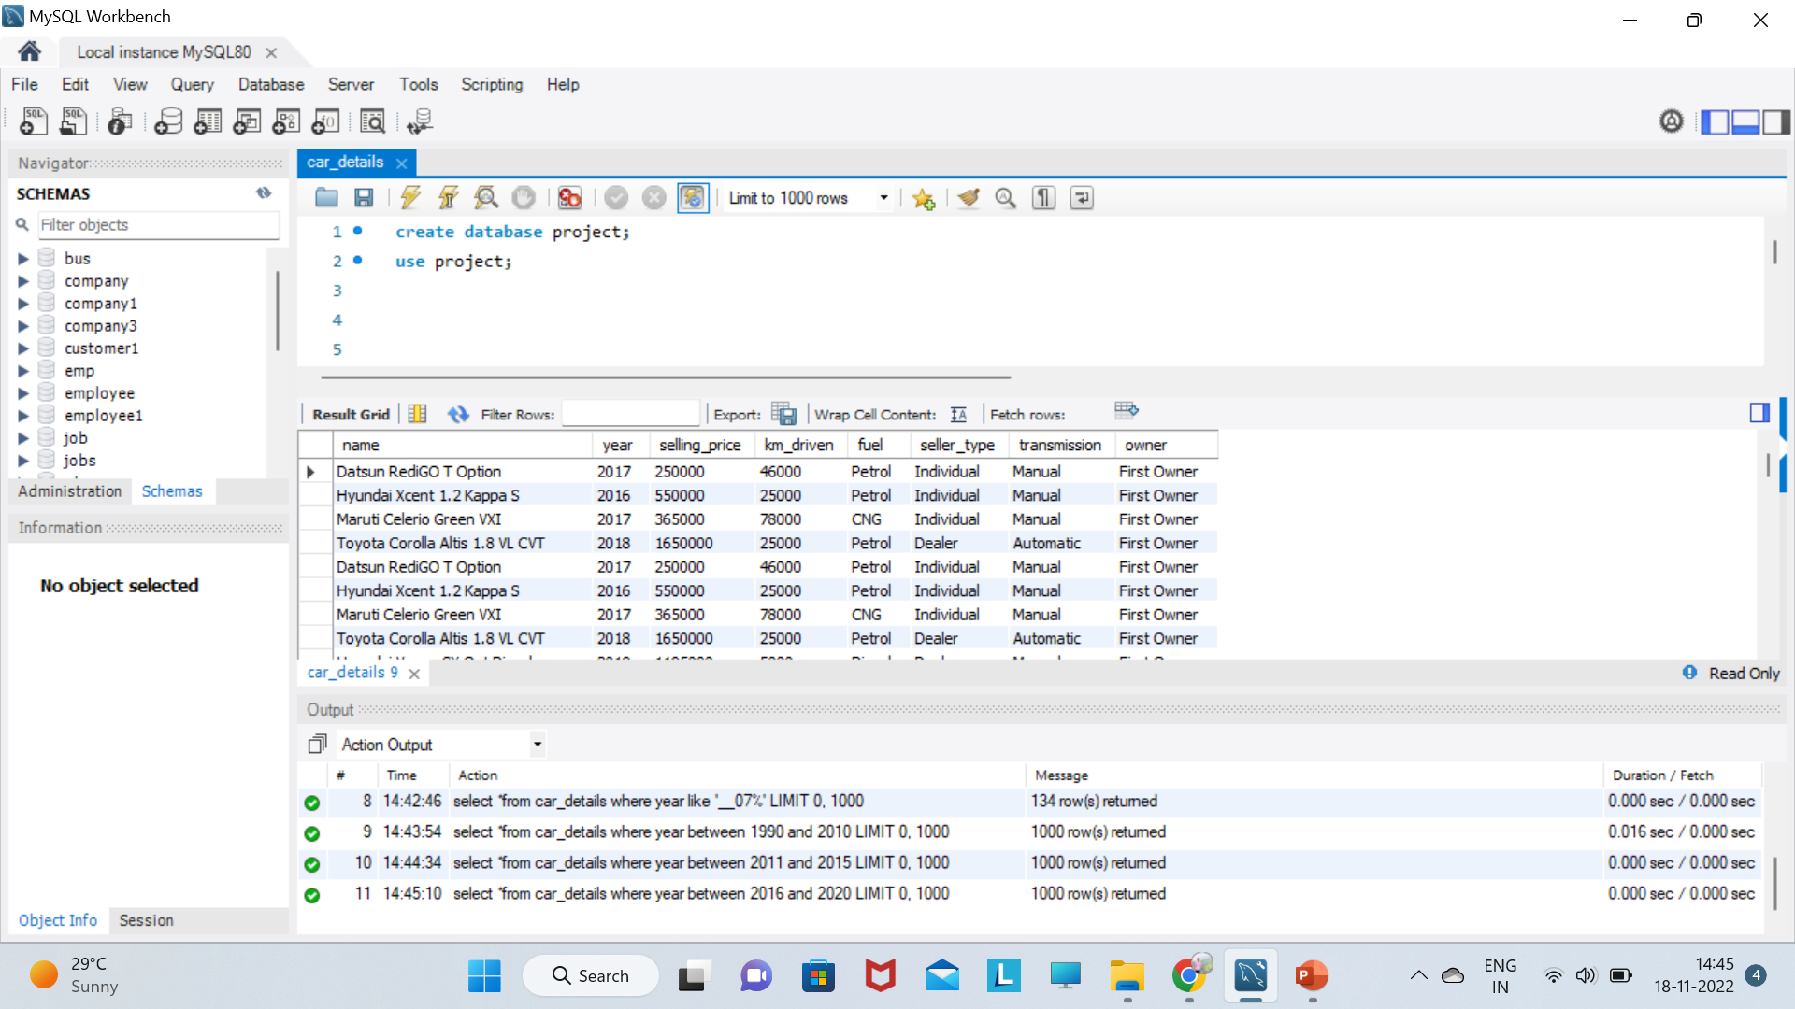
select *from car_details where year between 2016 and 2020;

Slide 10
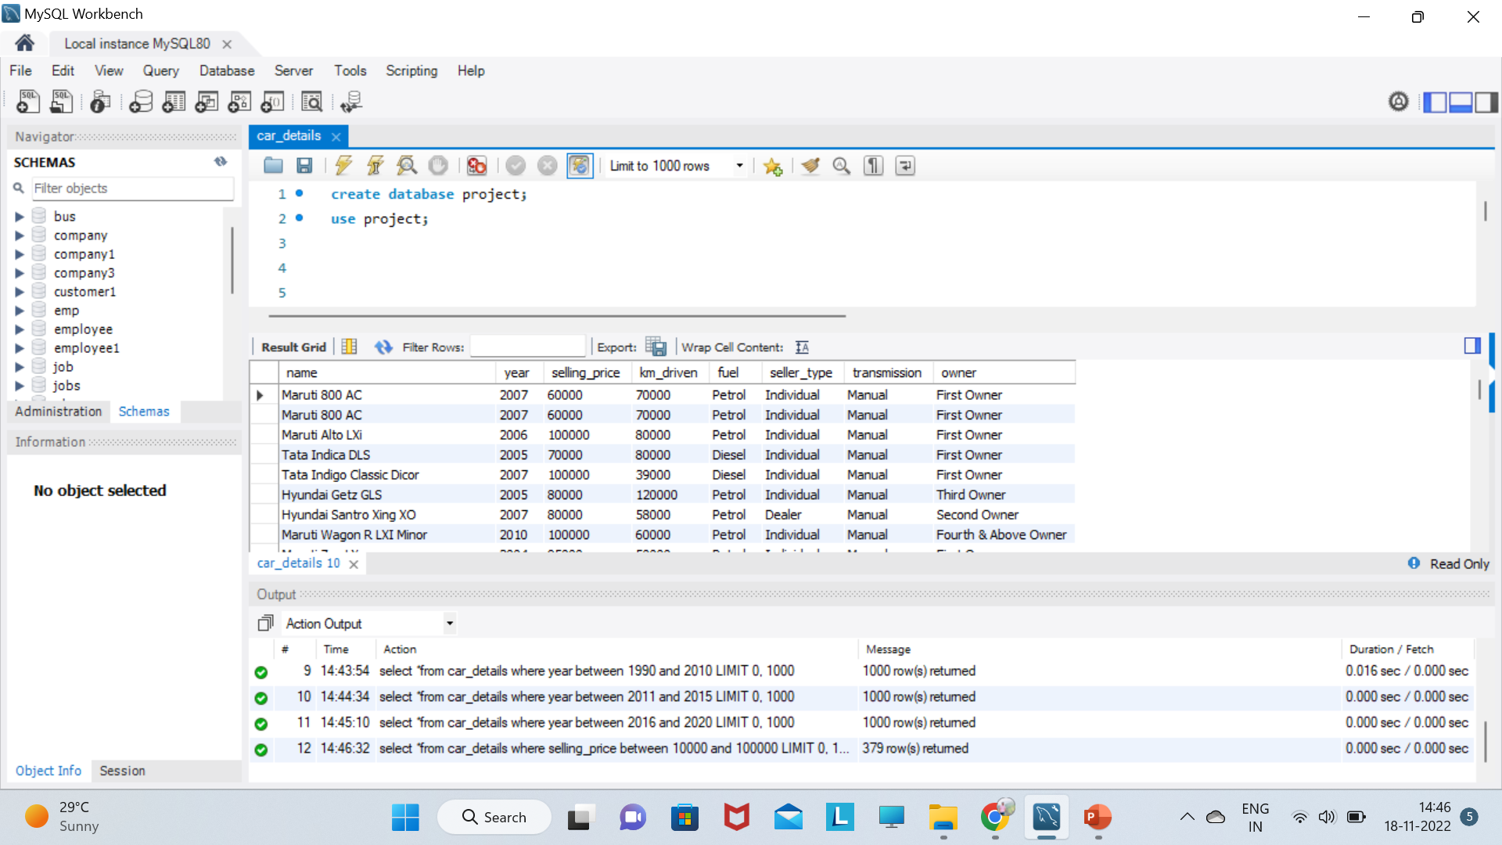
select *from car_details where selling_price between 10000 and 100000;

Slide 11
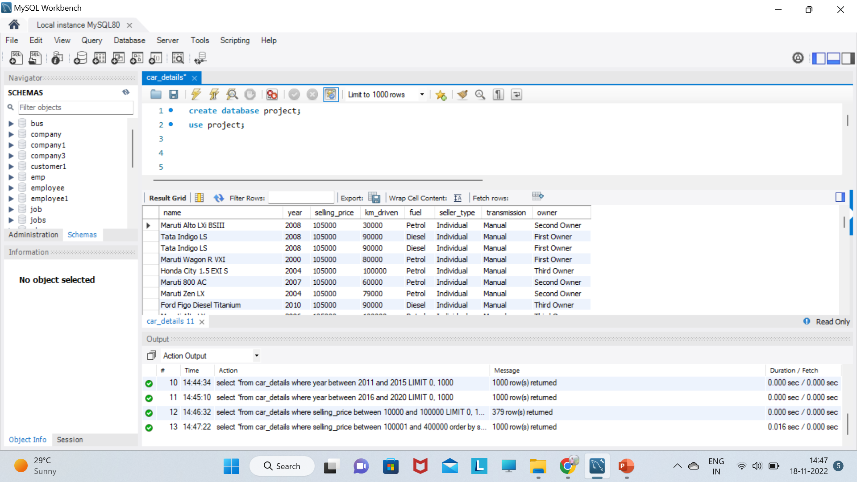
select *from car_details where selling_price between 100001 and 400000 order by selling_price;

Slide 12
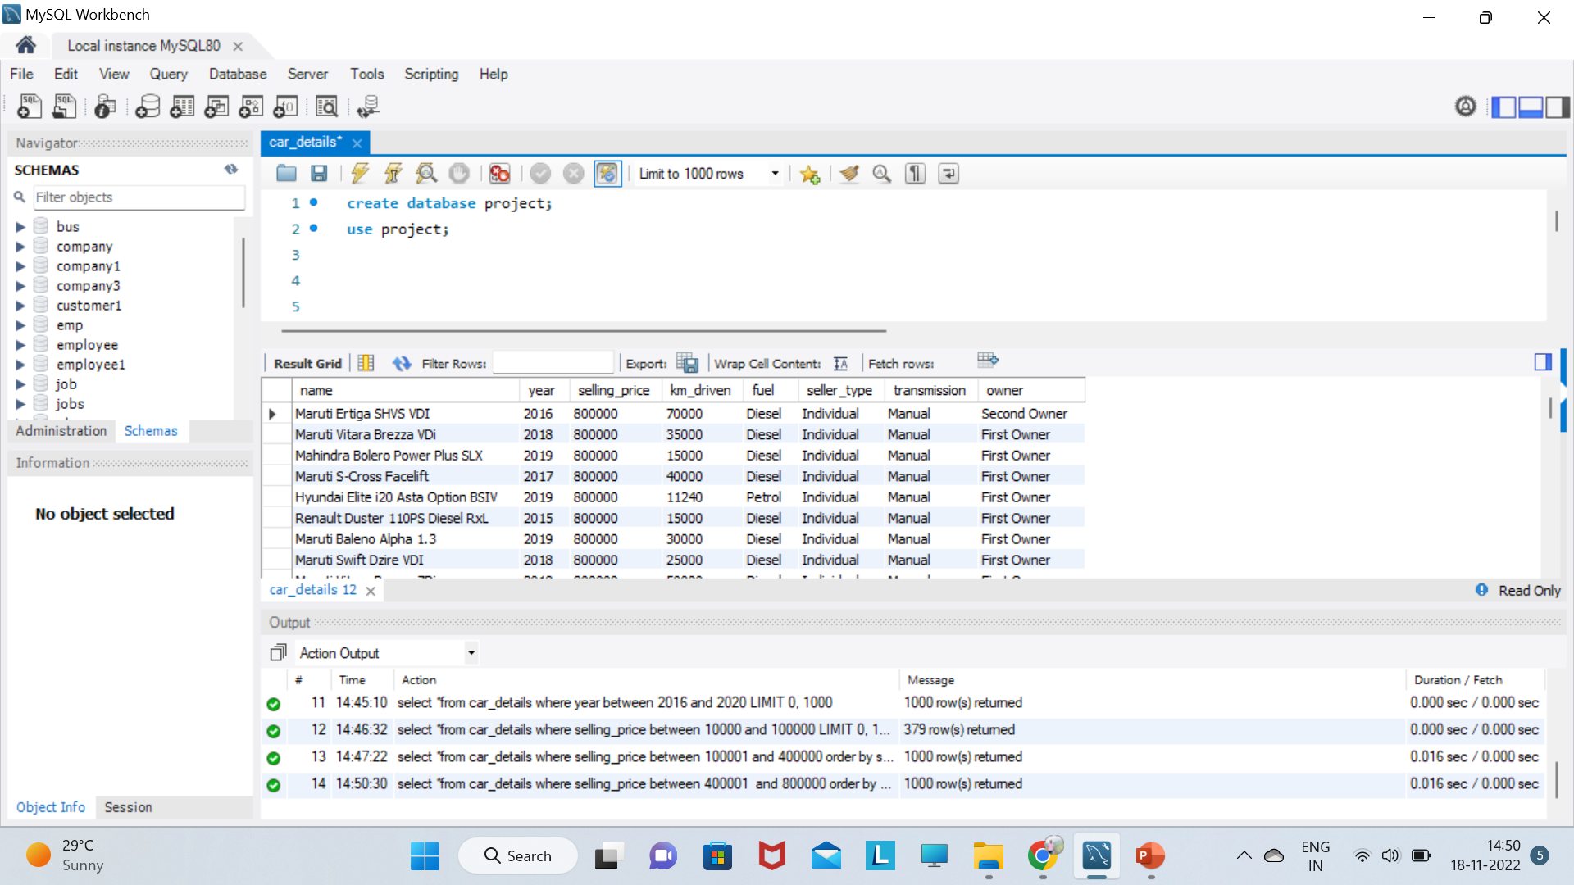
select *from car_details where selling_price between 400001 and 800000 order by selling_price desc;

Slide 13
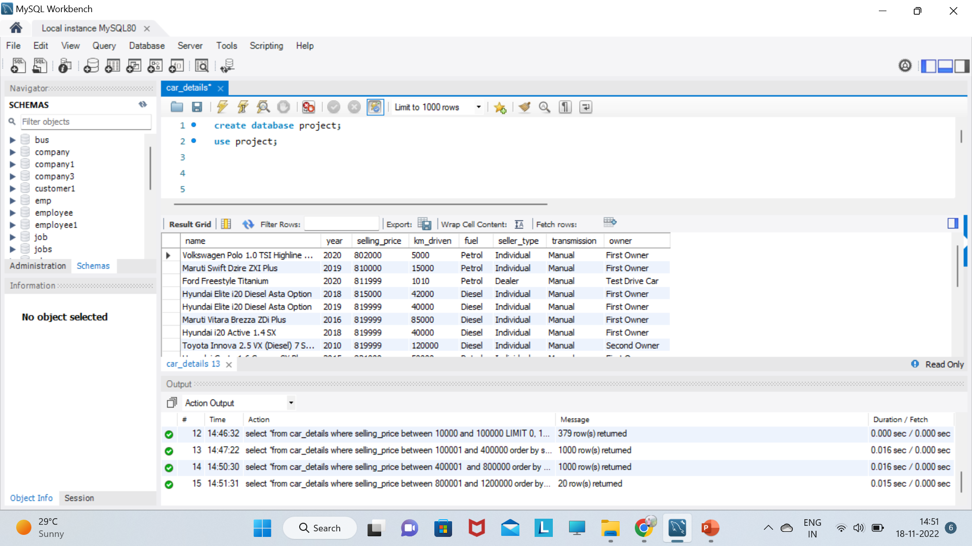
select *from car_details where selling_price between 800001 and 1200000 order by selling_price limit 20;

Slide 14
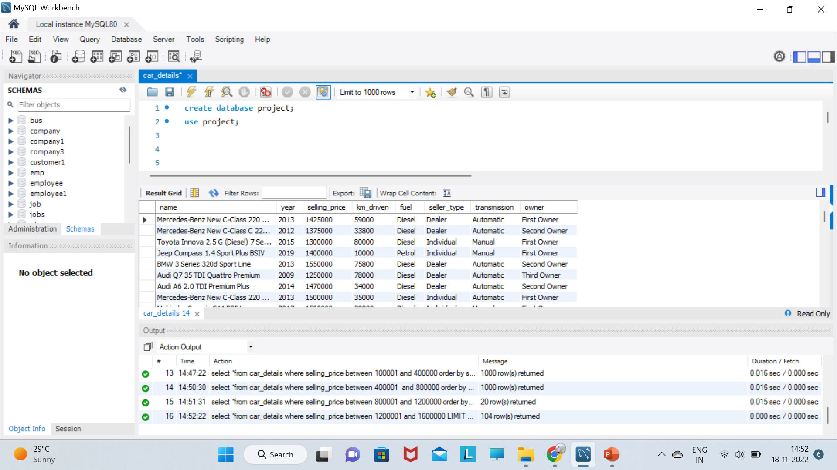
select *from car_details where selling_price between 1200001 and 1600000;

Slide 15
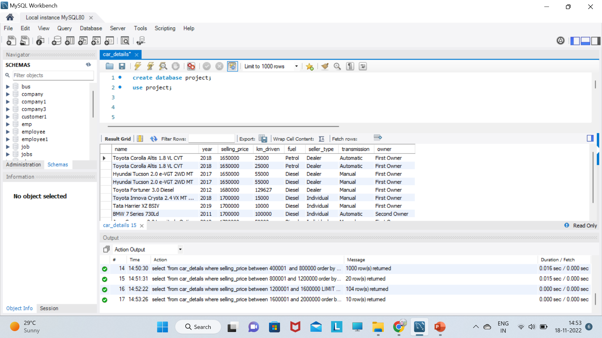
select *from car_details where selling_price between 1600001 and 2000000 order by selling_price limit 10;

Slide 16
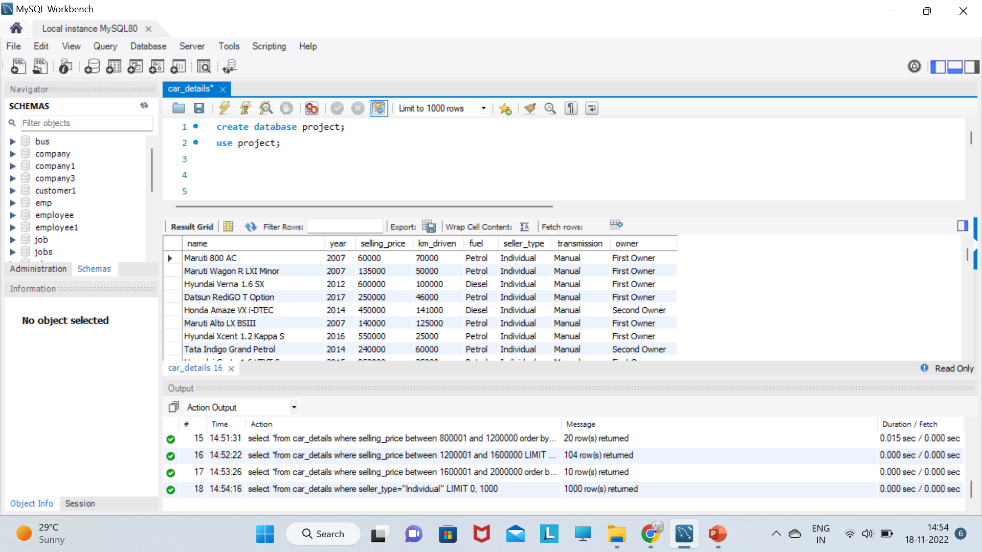
select *from car_details where seller_type="Individual";

Slide 17
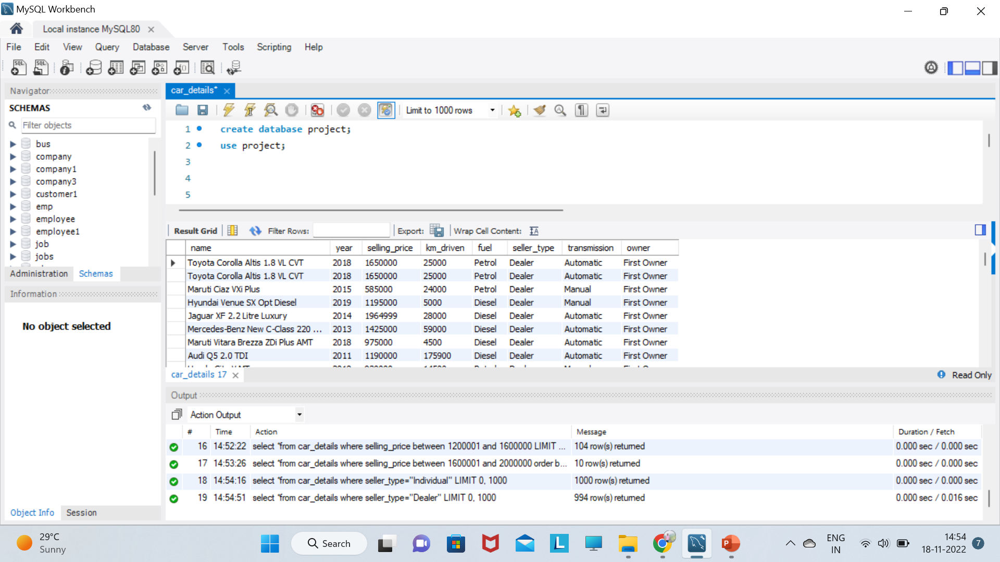
select *from car_details where seller_type="Dealer";

Slide 18
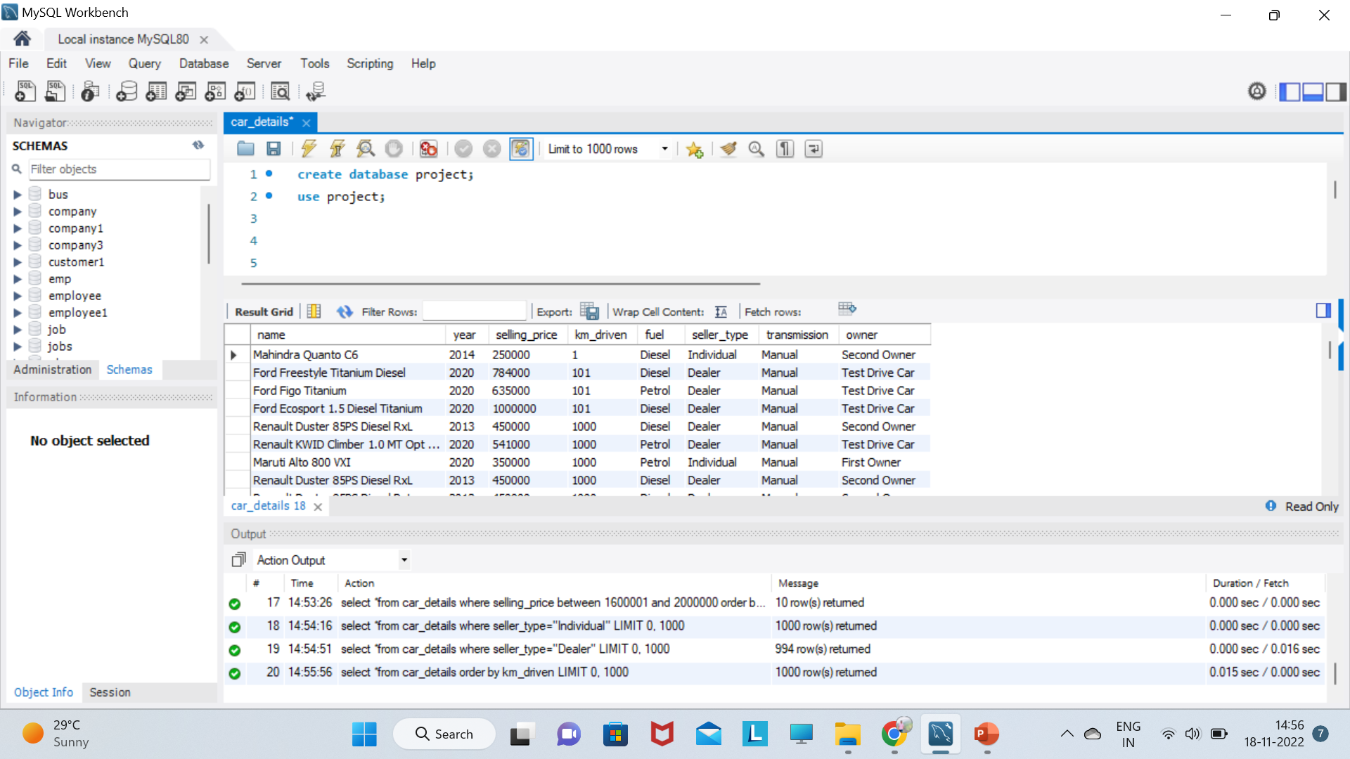
select *from car_details order by km_driven;

Slide 19
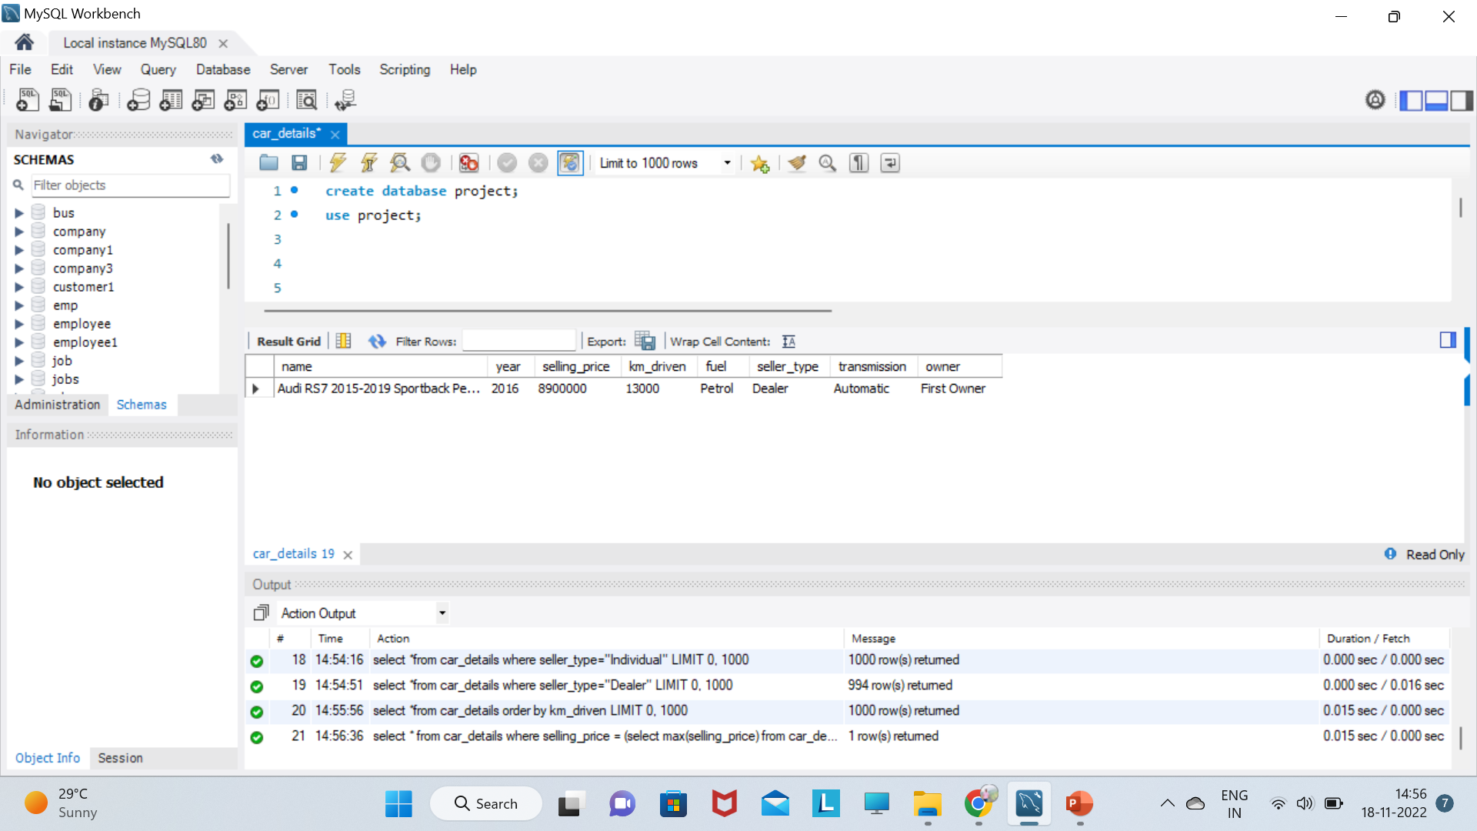
select * from car_details where selling_price = (select max(selling_price) from car_details);

Slide 20
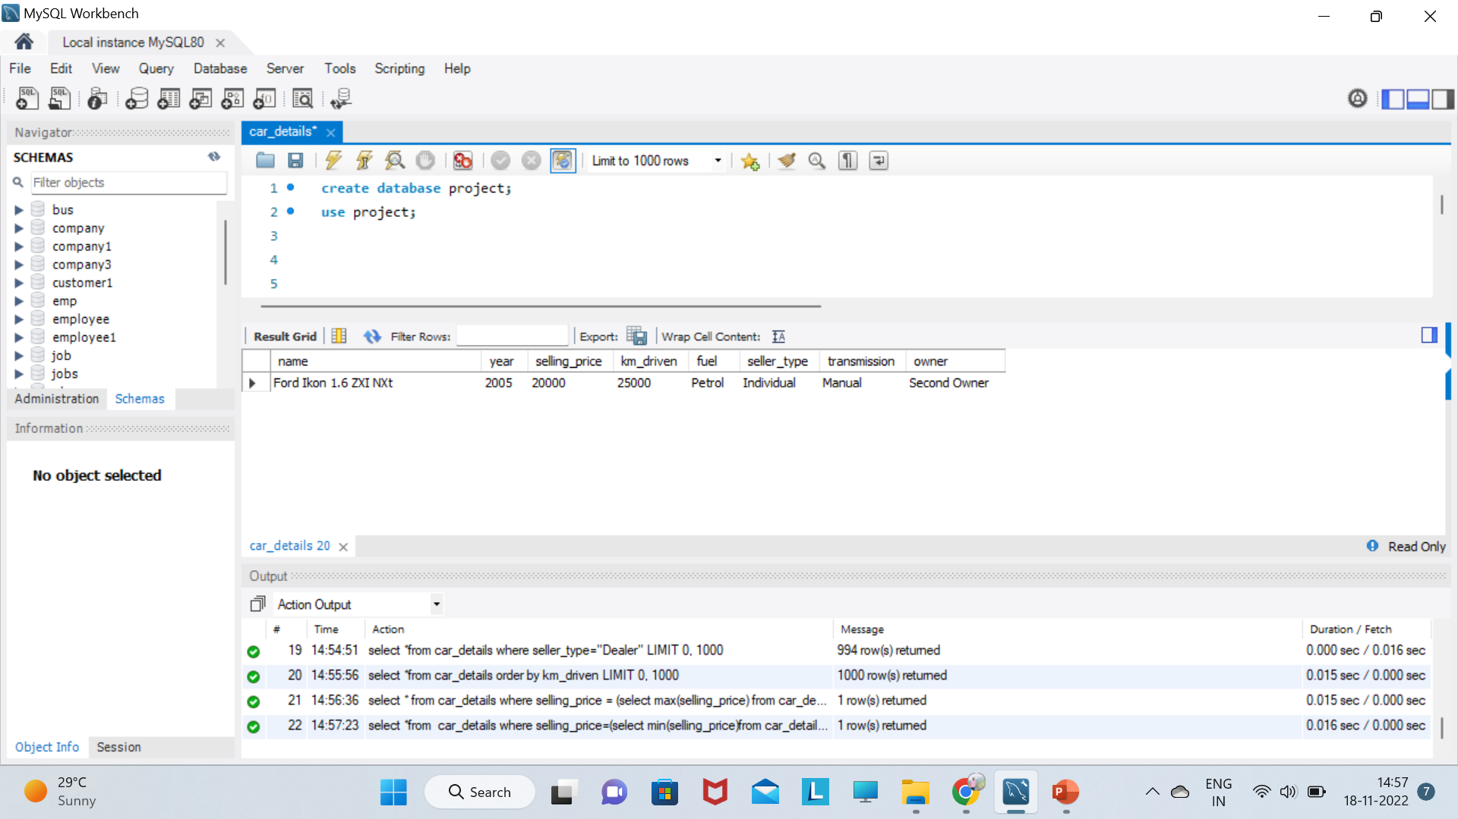
select *from car_details where selling_price=(select min(selling_price)from car_details);

Slide 21
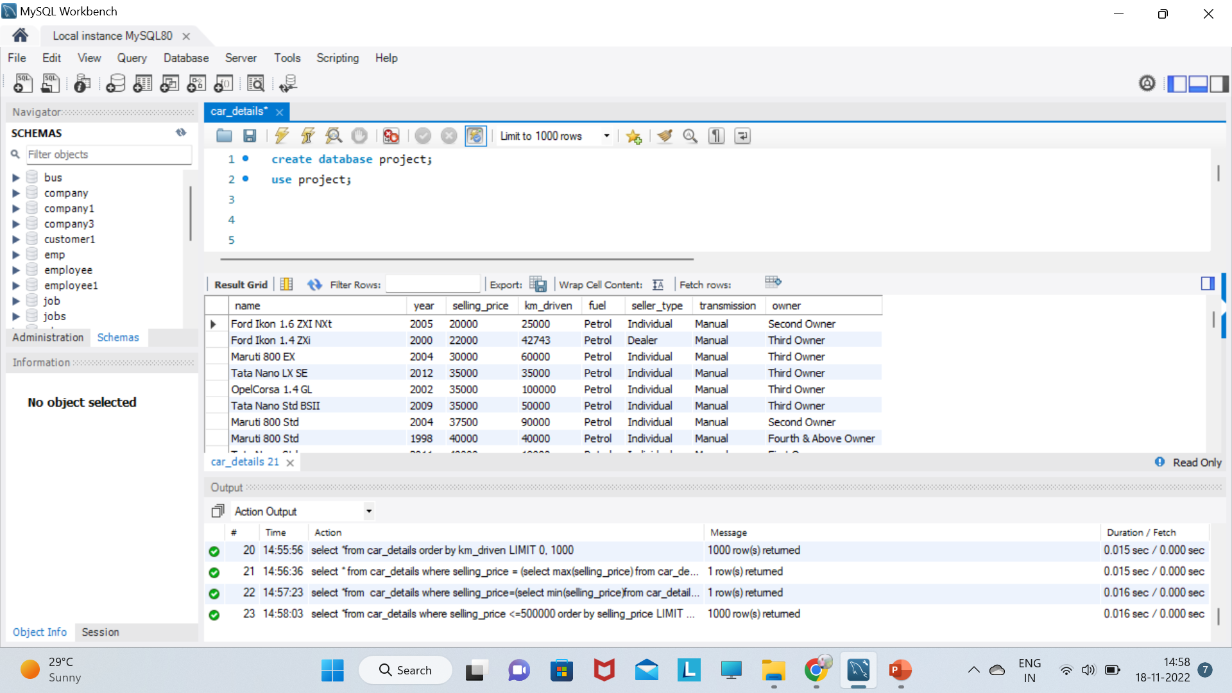
select *from car_details where selling_price <=500000 order by selling_price;

Slide 22
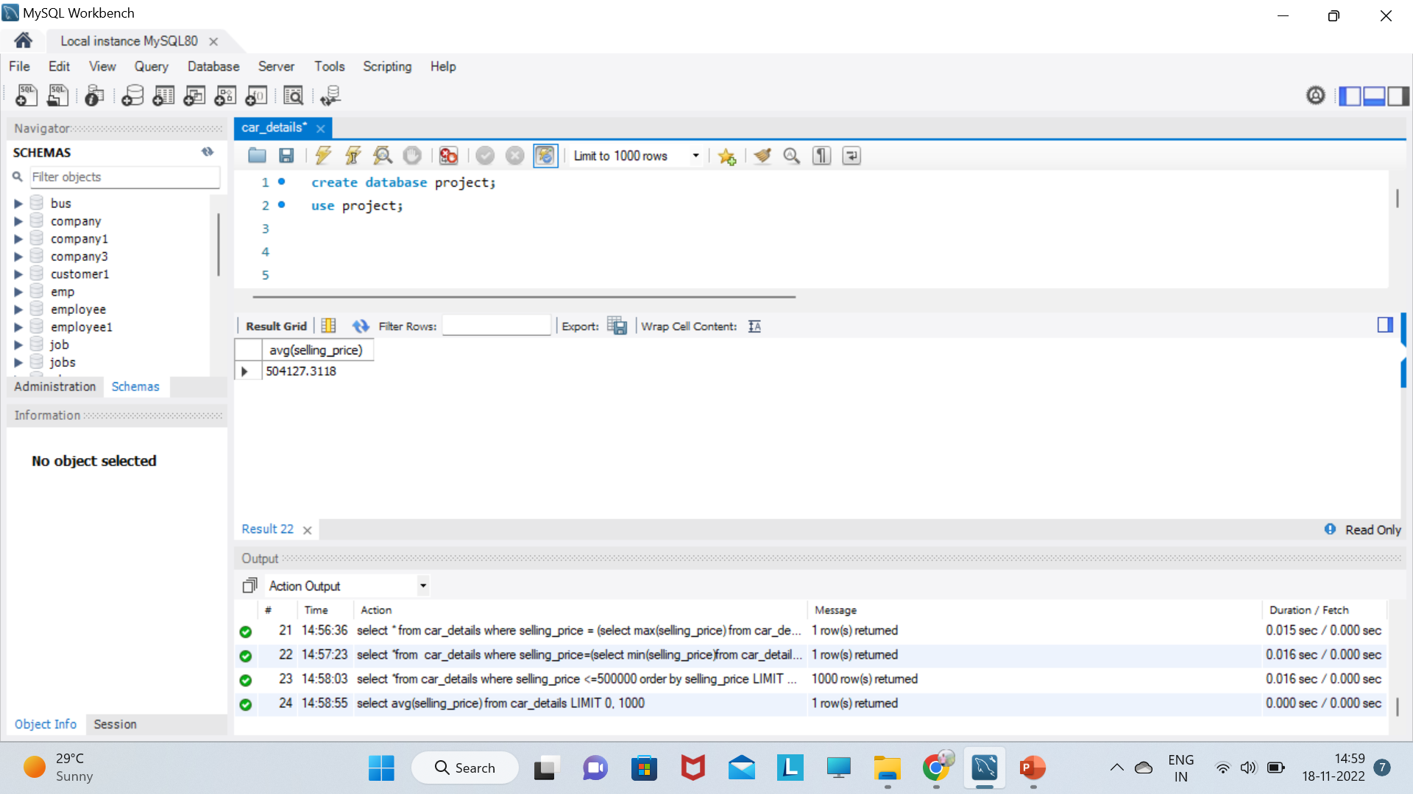
select avg(selling_price) from car_details;

Slide 23
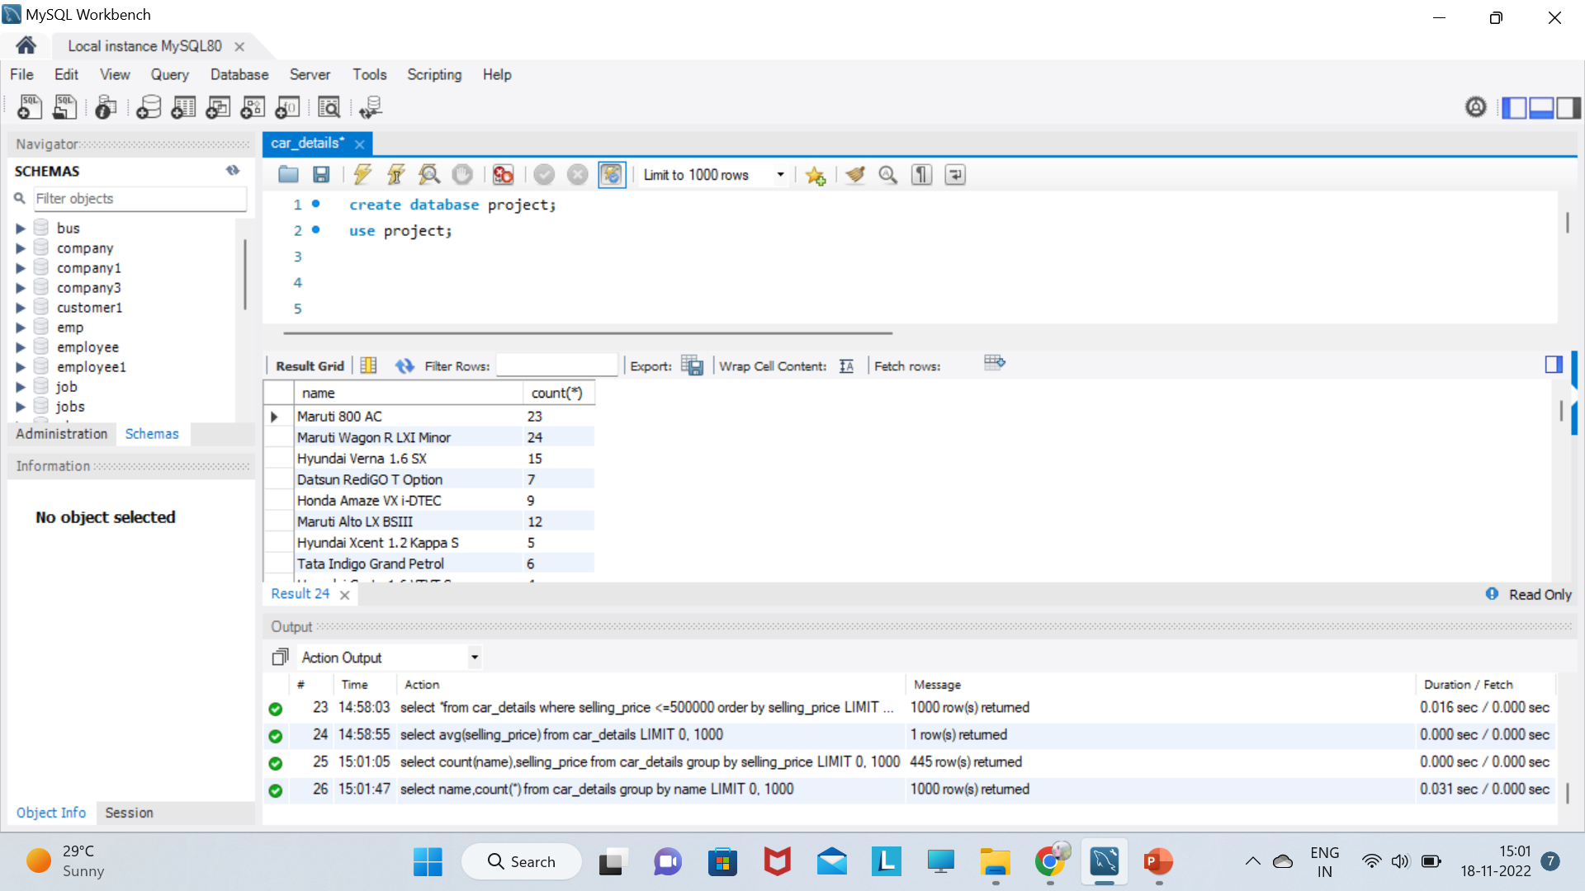
select name,count(*) from car_details group by name;

Slide 24
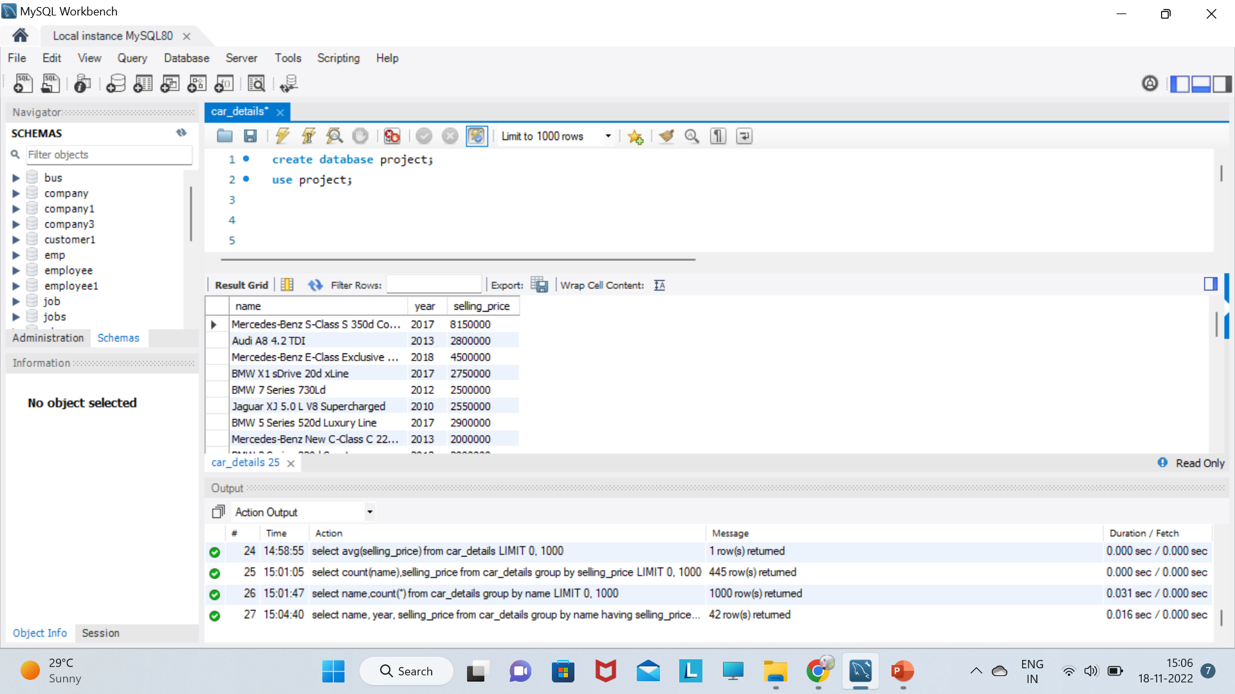
select name, year, selling_price from car_details group by name having selling_price>=2000000;

Slide 25
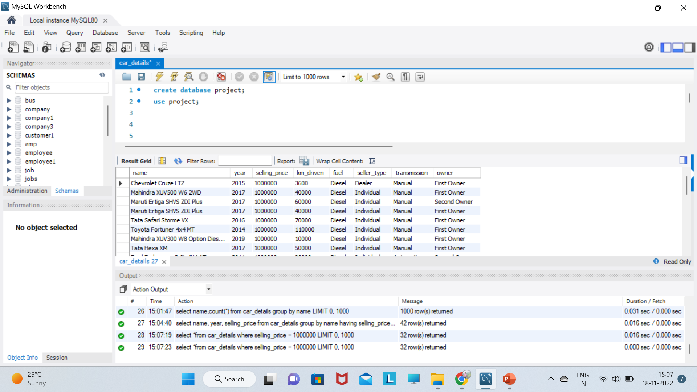
select *from car_details where selling_price = 1000000;

Slide 26
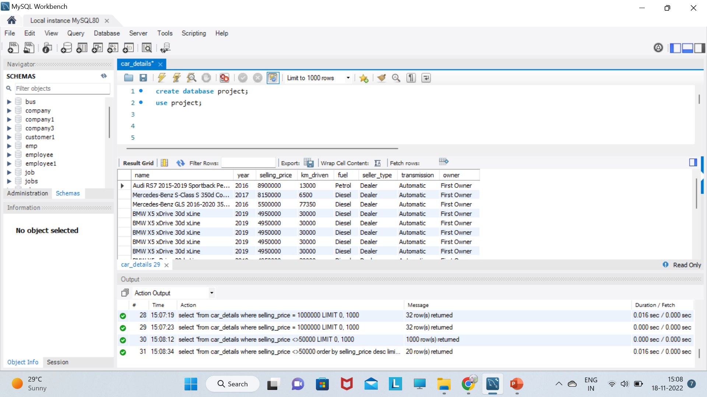
select *from car_details where selling_price <>50000 order by selling_price desc limit 20;

Slide 27
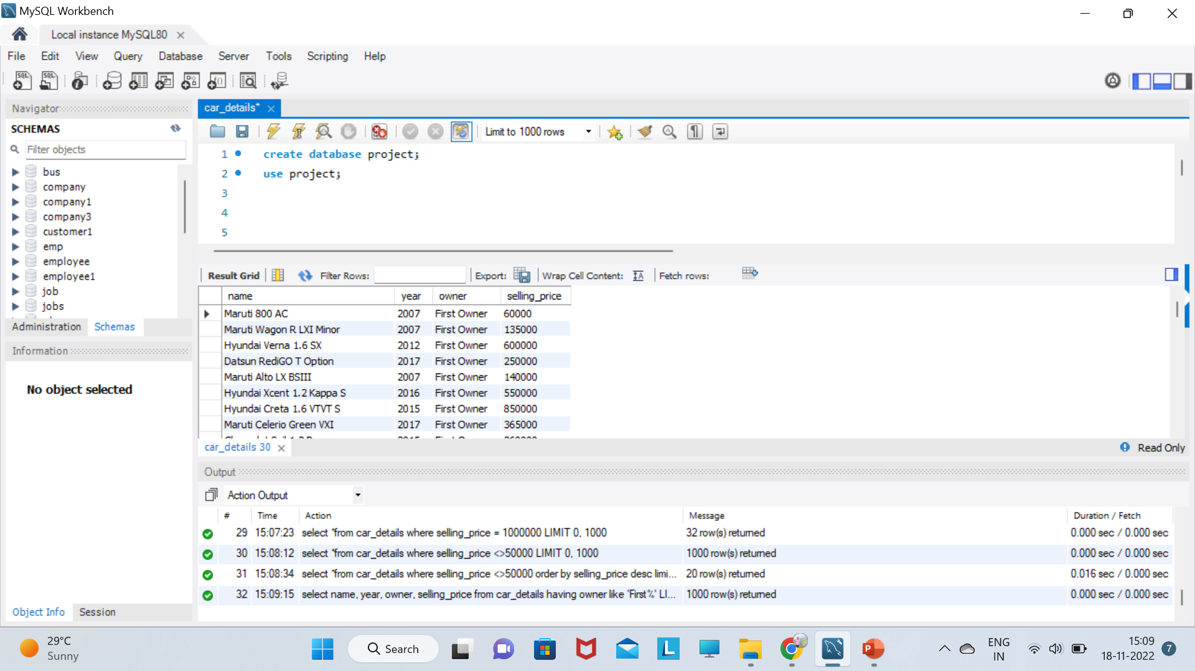
select name, year, owner, selling_price from car_details having owner like 'First%';

Slide 28
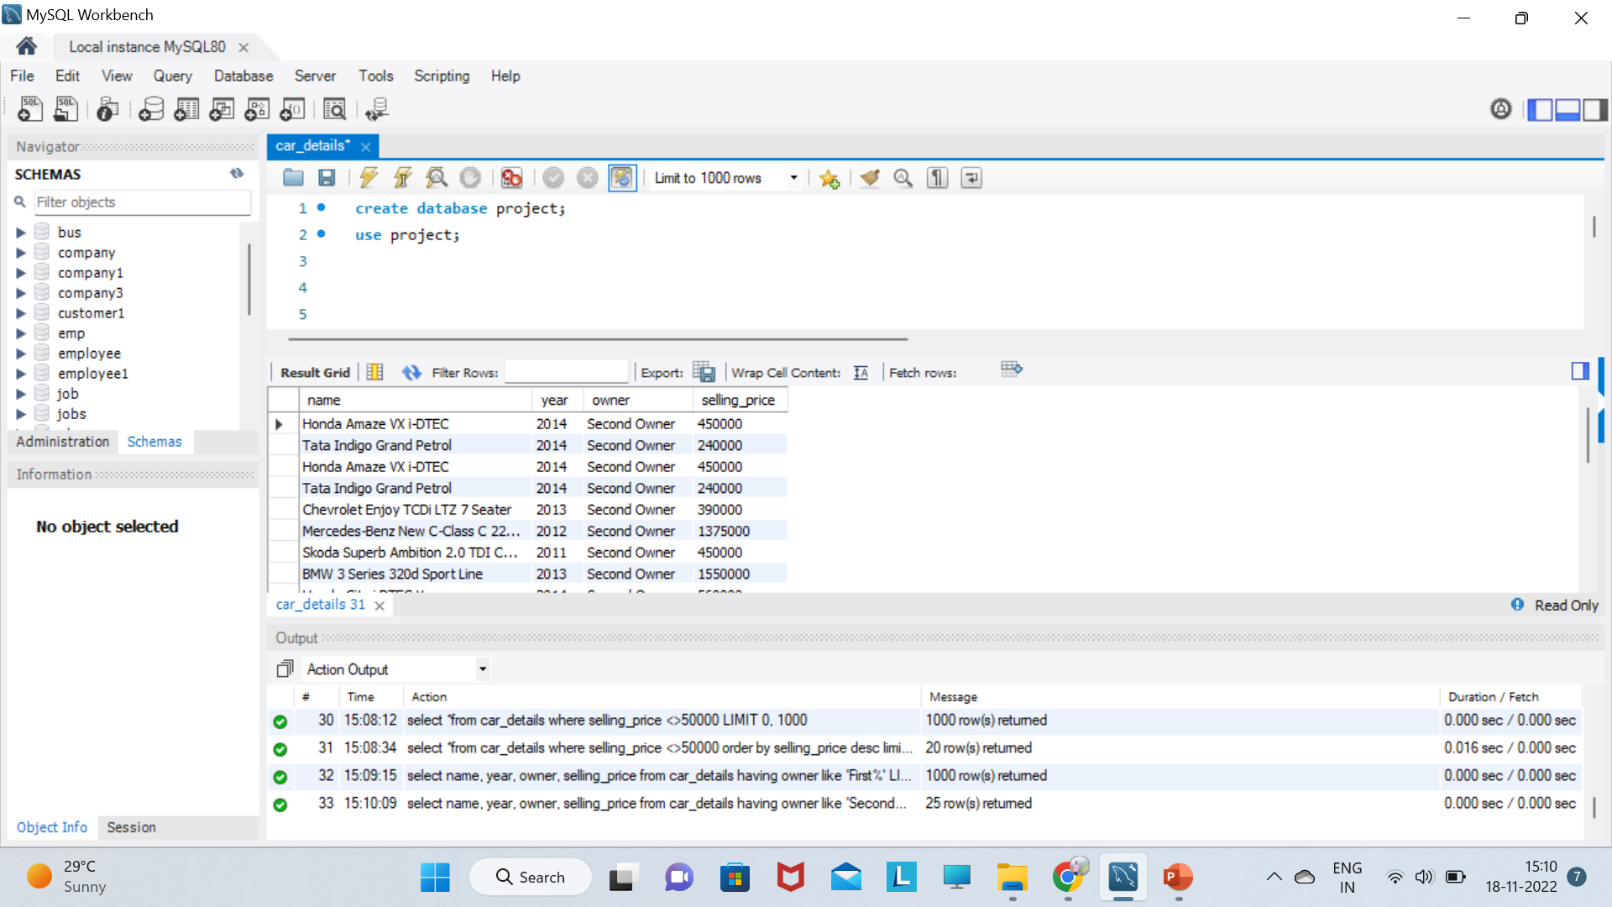
select name, year, owner, selling_price from car_details having owner like 'Second%' limit 25;

Slide 29
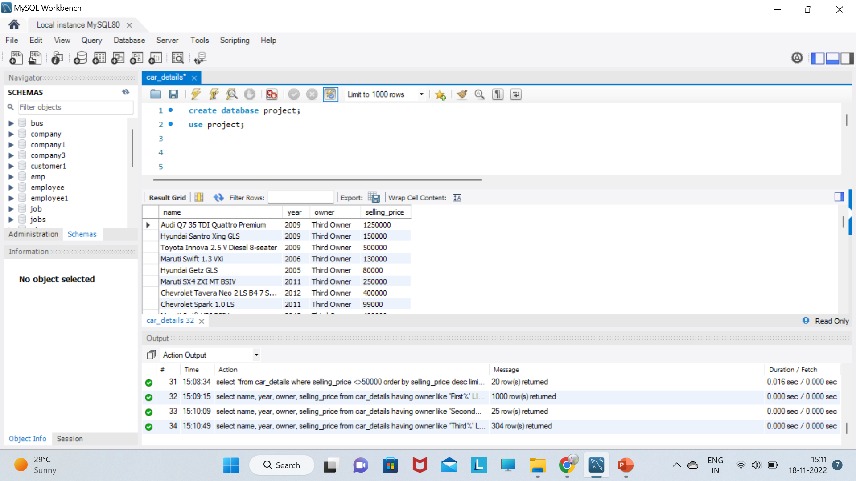
select name, year, owner, selling_price from car_details having owner like 'Third%';

Slide 30
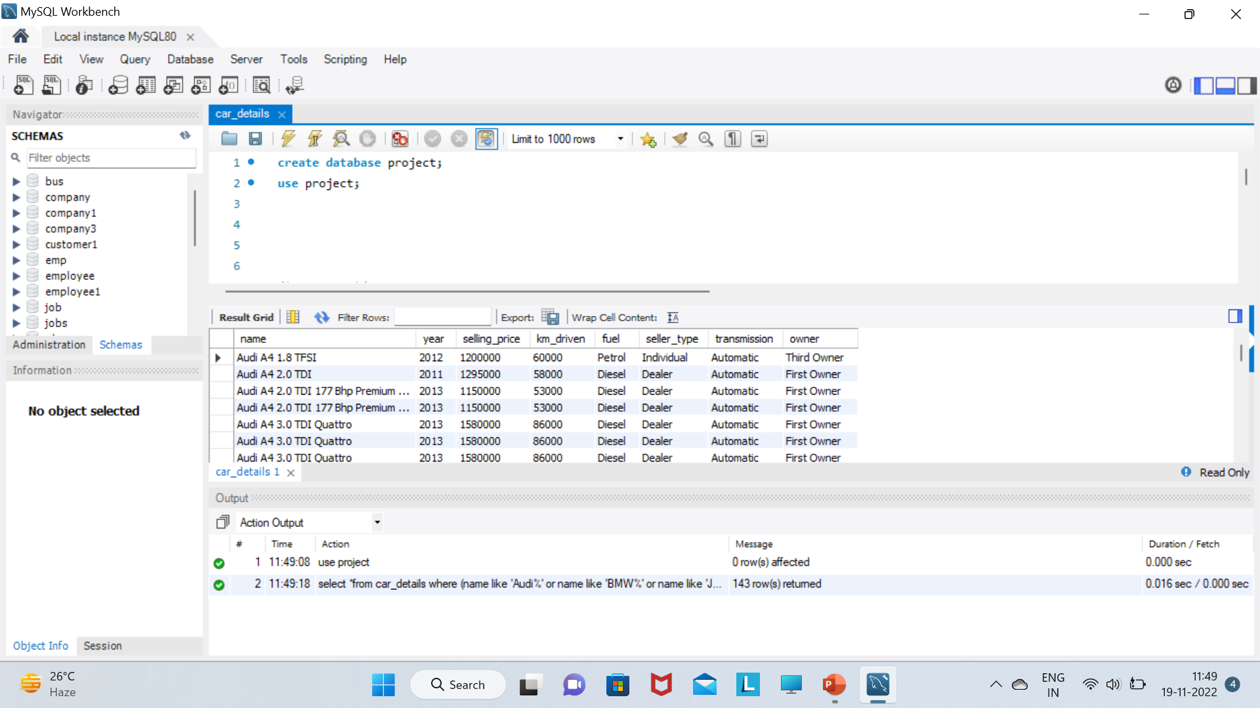
select *from car_details where (name like 'Audi%' or name like 'BMW%' or name like 'Juguar%' or name like 'Land%'or name like 'Mercedes%' or name like 'Volvo%') order by name;

Slide 31
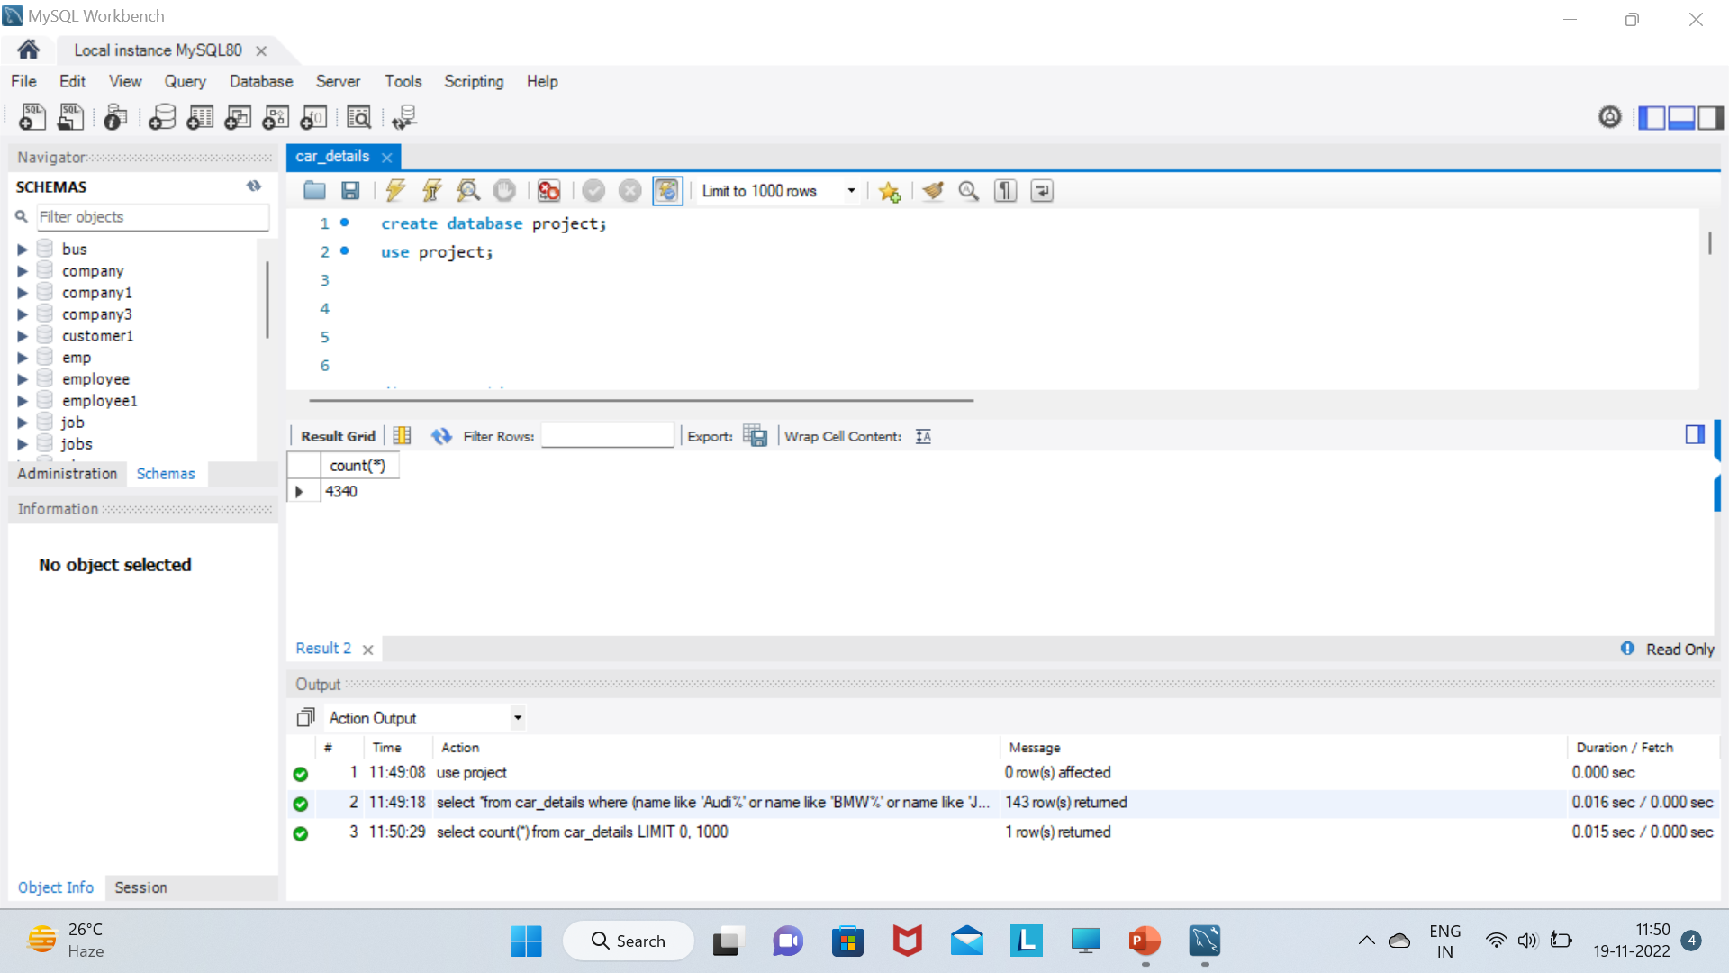
select count(*) from car_details;

Slide 32
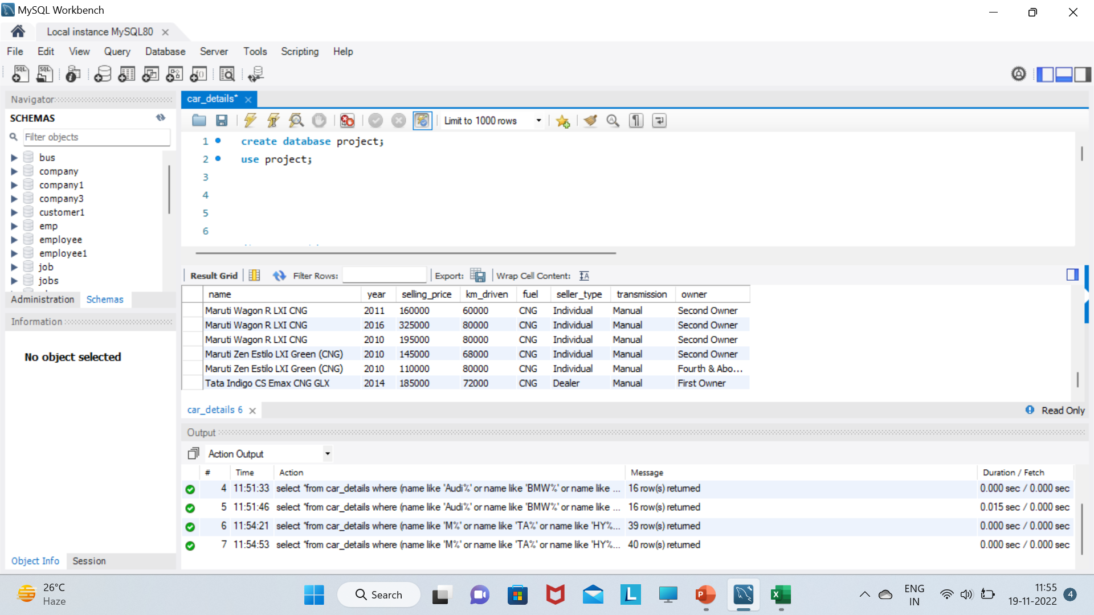
select *from car_details where (name like 'M%' or name like 'TA%' or name like 'HY%' or name like ‘HO%'or name like 'CH%' or name like 'TO%') having fuel like 'CNG%' order by name;

Slide 33
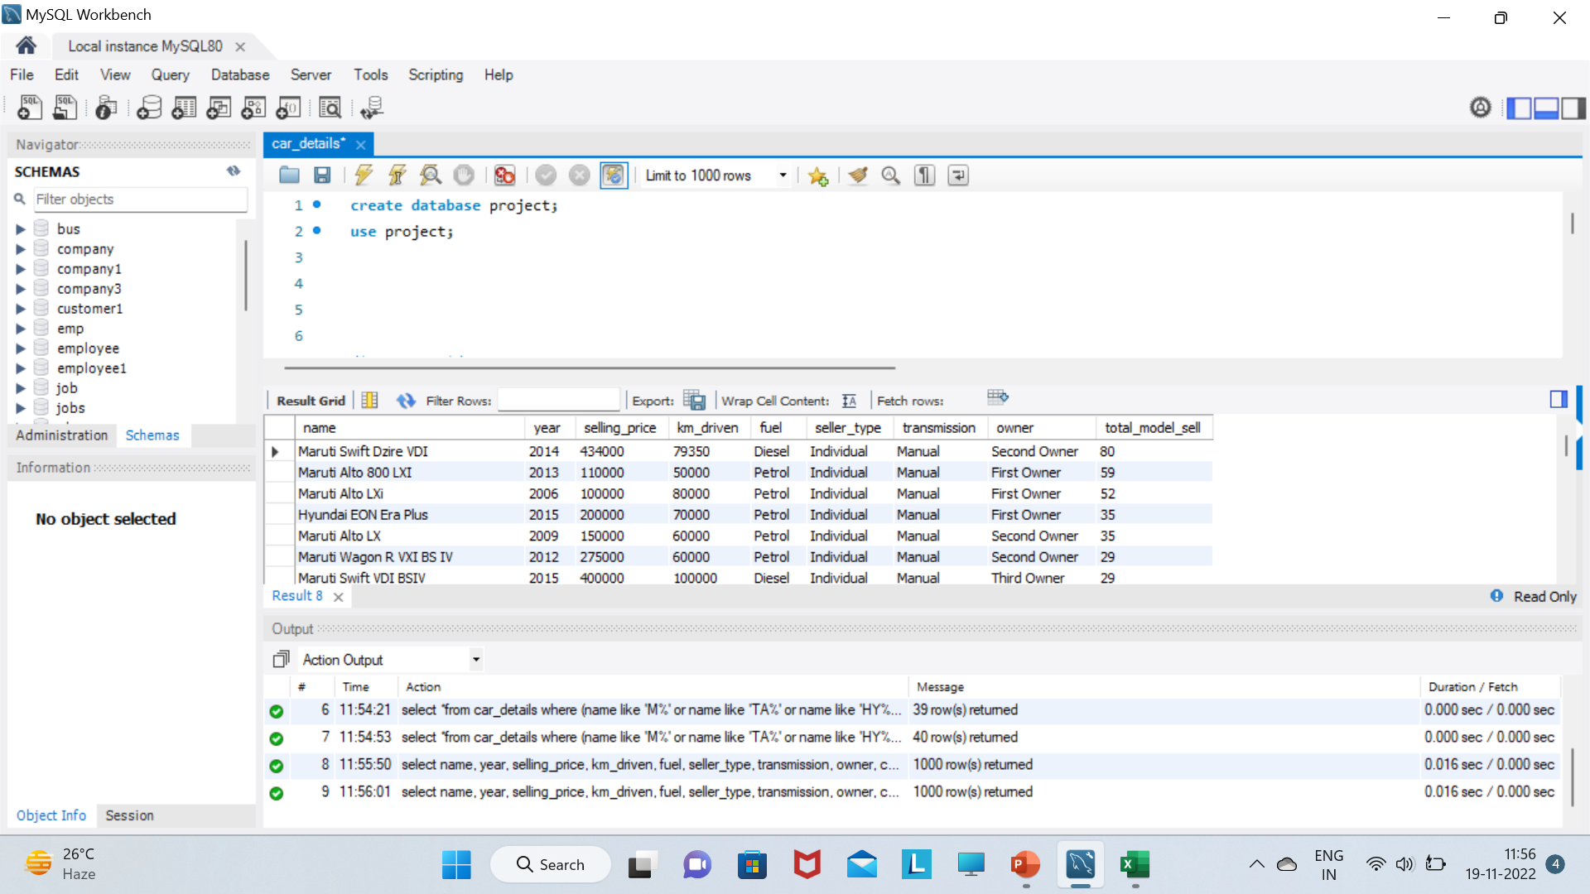
select name, year, selling_price, km_driven, fuel, seller_type, transmission, owner, count(name) as total_model_sell from car_details group by name order by total_model_sell desc;

Slide 34
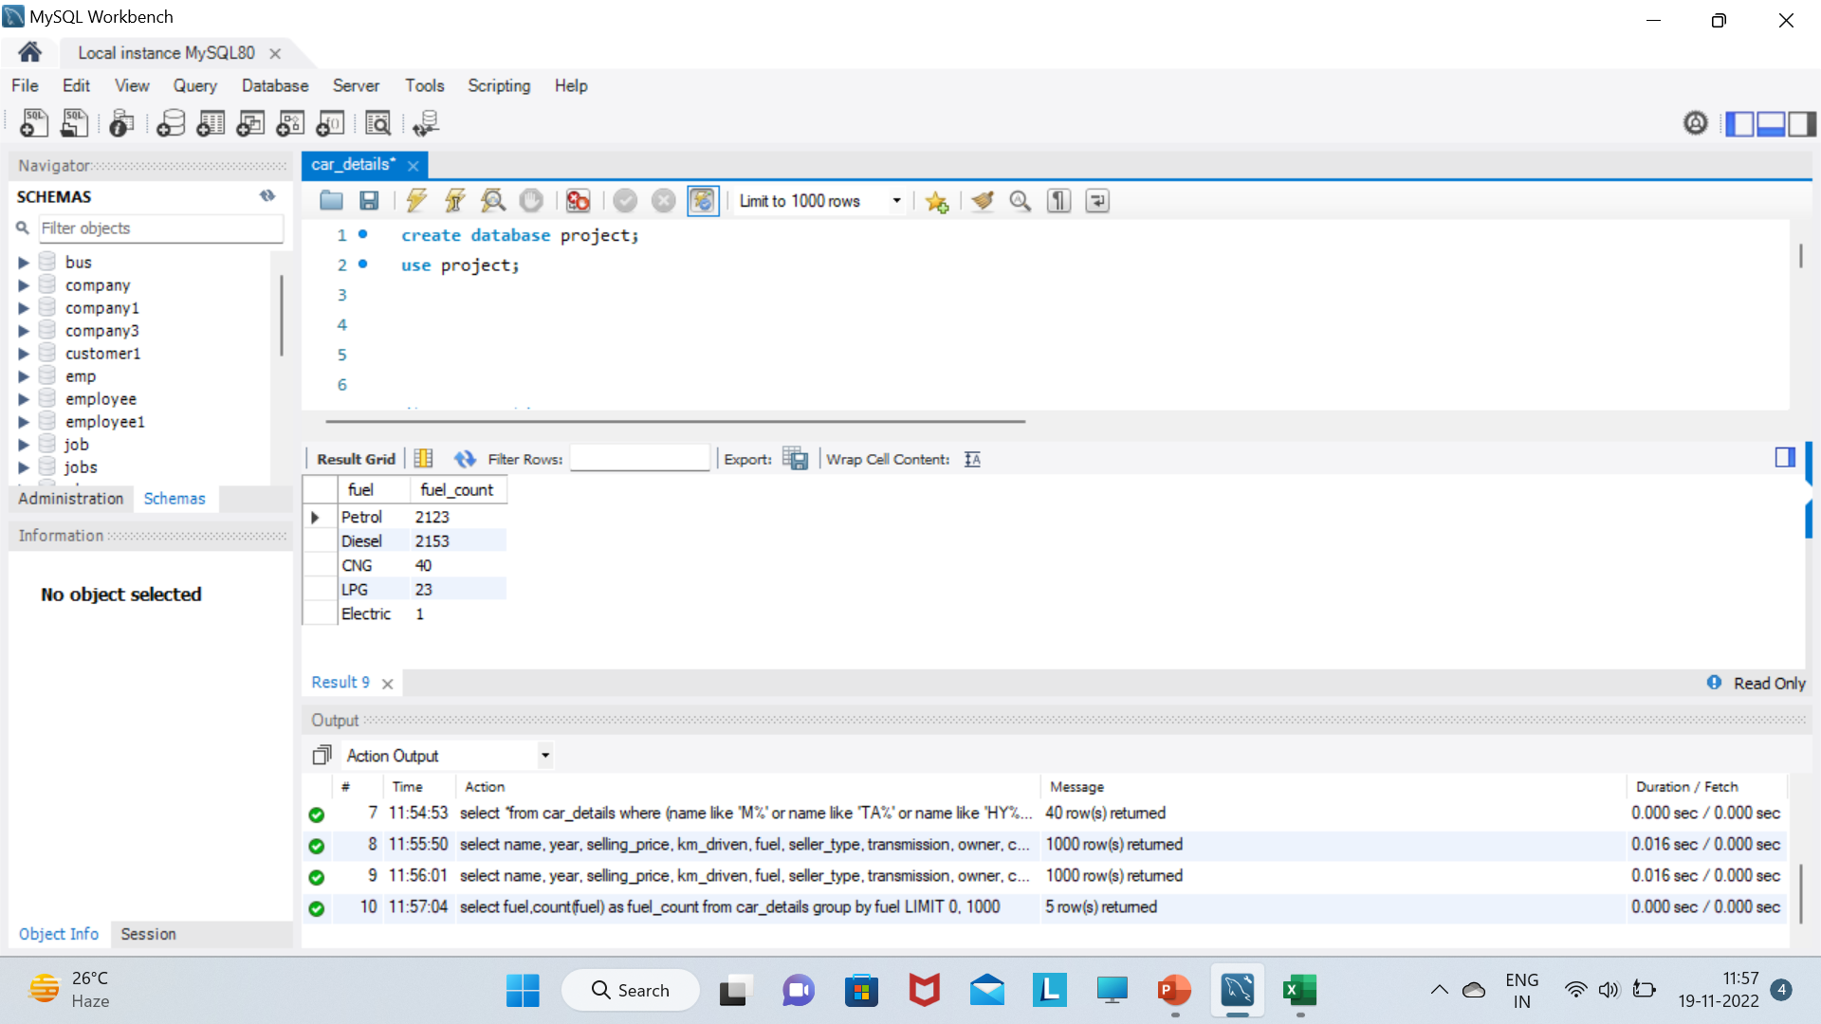
select fuel,count(fuel) as fuel_count from car_details group by fuel;

Slide 35
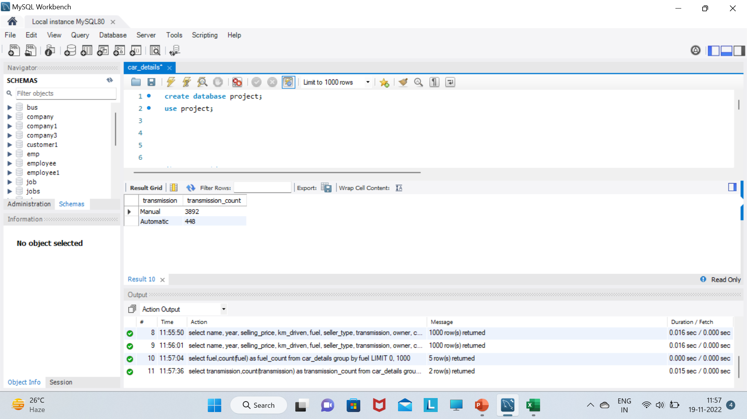
select transmission,count(transmission) as transmission_count from car_details group by transmission;

Slide 36
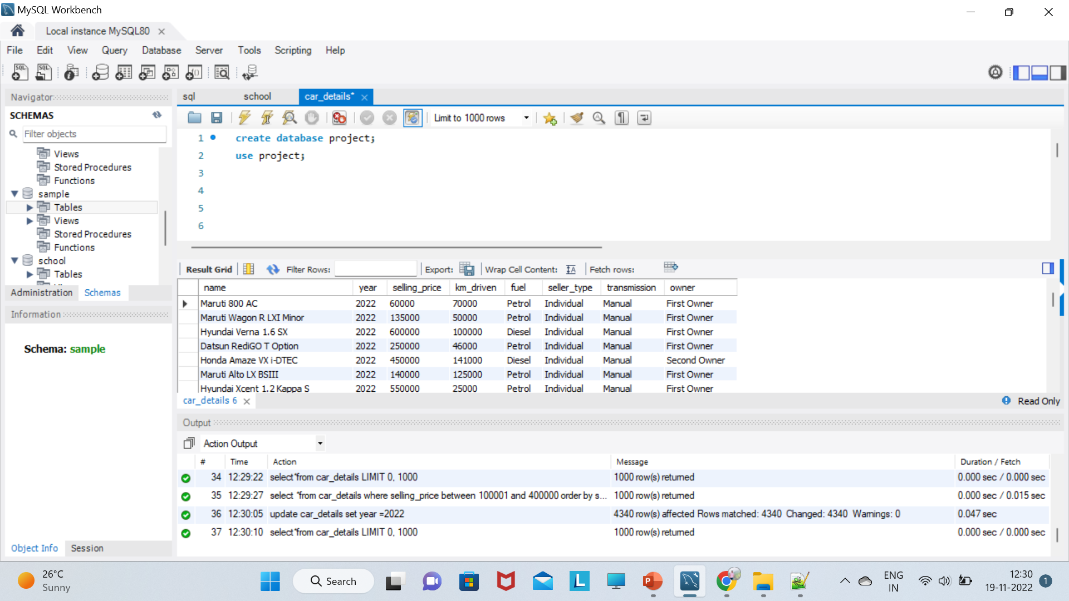
update car_details set year =2022;

Slide 37
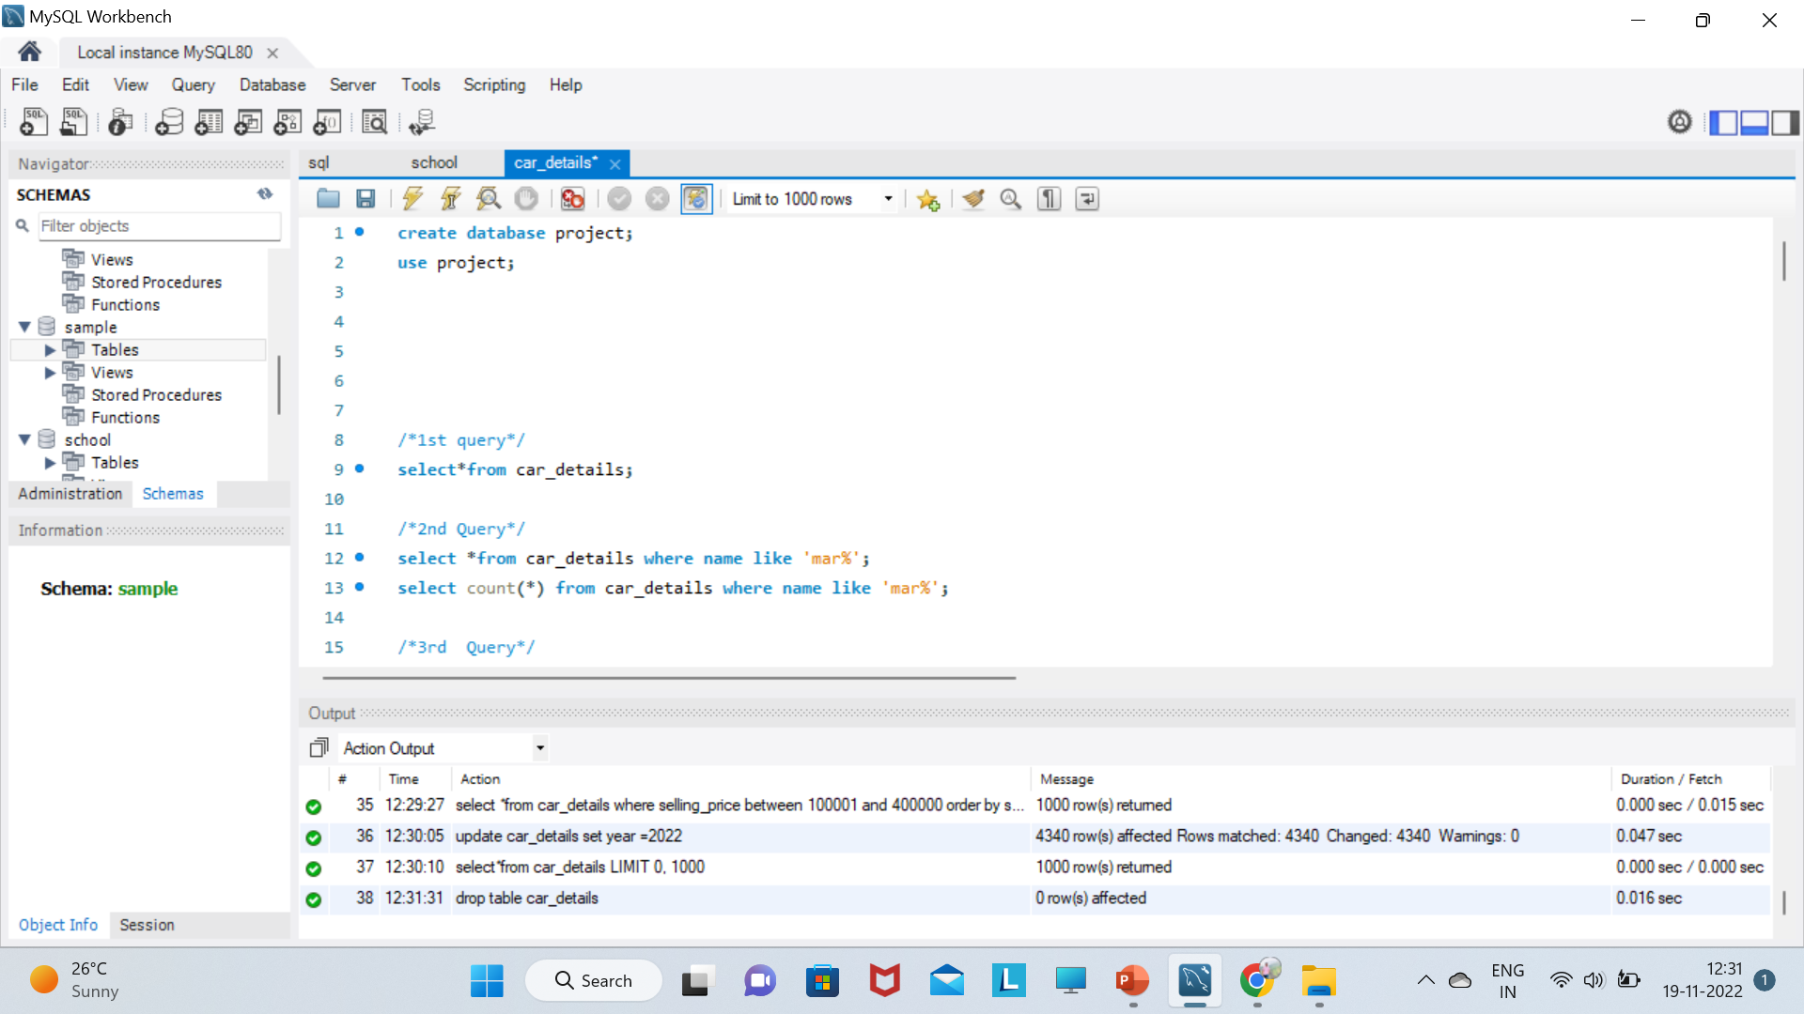
drop table car_details;

Slide 38
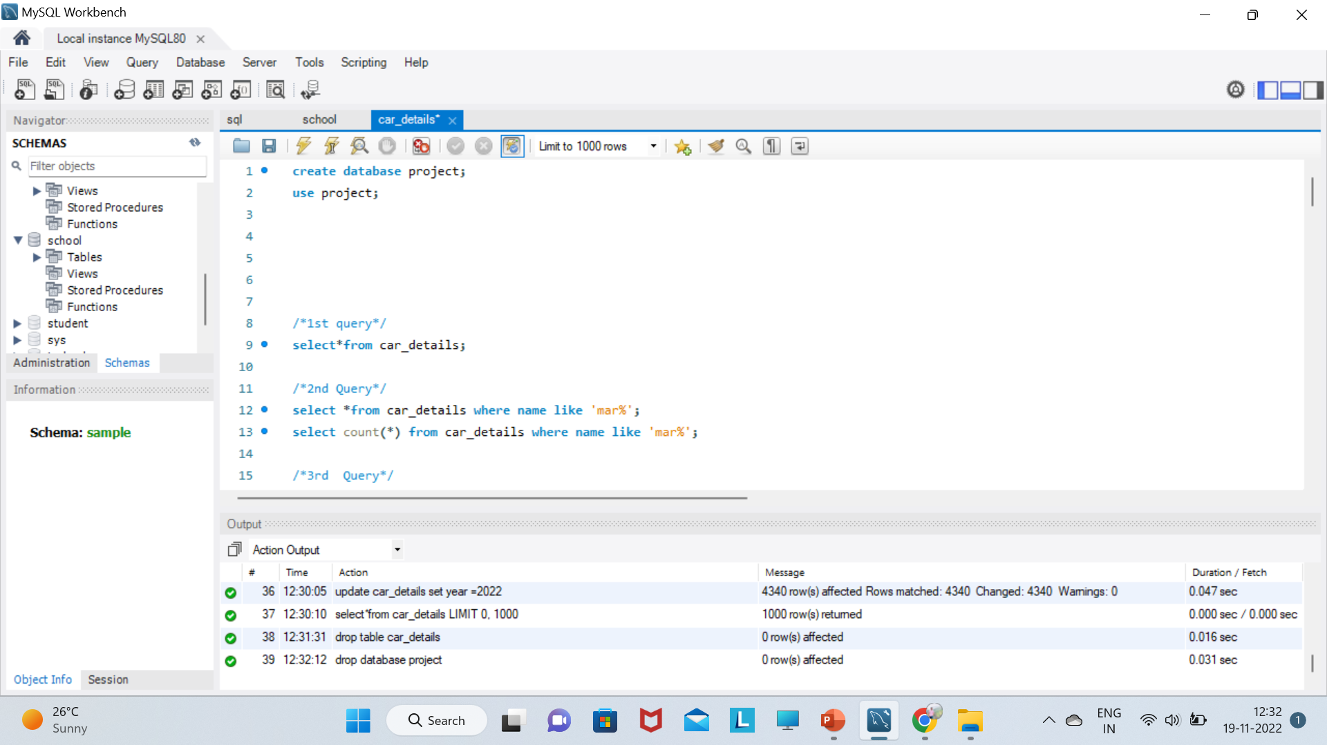
drop database project;

